Slide 1
Complaint Pattern Analysis
of Mumbai BMC Civic Complaints
Data Warehousing & Data Mining (CSI3010) — Lab Project Week 1
Team: Anshul Singh (24MID0291), Aarav Jha (24MID0285), Omkar Londhe (24MIC0135)
Faculty: Dr. Adrija Bhattacharya | Slot: L55+L56 | Date: 09-10-2026
Notes:
Introduce the complaint warehouse and its purpose: analysing civic complaint patterns across time, wards and categories.
Source: README.md, project overview
Repository: https://github.com/Omkar-D-Londhe/BMC-Civic-Complaint-DWDM

Slide 2
Dataset Description
Property | Details
Dataset name | Mumbai BMC Civic Complaints
Source | Kaggle competition MCGM / BMC grievance system
Size | Train: 960,000 × 35 columns Test: 240,000 × 34 columns
Time period | 2018-01-01 to 2024-12-30
Format | CSV files
Domain | Municipal governance / Smart Cities
Why this dataset?
Compare complaint categories and ward hotspots.
Look at seasonal resolution delays and contractor outcomes.
Audit result: zero missing values, zero duplicate complaint IDs.
Planned mining: classification, ward clustering, association rules, satisfaction prediction.
Notes:
The warehouse uses the training split. The test split withholds citizen_satisfied. Kaggle was unreadable, so size, period and provenance follow the README. Raw dataset and dictionary entries in the ZIP are Git LFS pointers.
Source: README.md, dataset description and audit; notebook loading output; Kaggle: https://www.kaggle.com/competitions/mumbai-nagar-seva-bmc-civic-complaint-resolution-2018-2024/data
Repository: https://github.com/Omkar-D-Londhe/BMC-Civic-Complaint-DWDM

Slide 3
Attribute Summary: Keys & Dimensions
Attribute | Type | Description | Role in DW
complaint_id | String | Unique complaint identifier | Key
complaint_date | Date | Filing date | Dimension
year, month | Integer | Filing year and month | Dimension
is_monsoon_season | Integer | 1 for June–September | Dimension
complaint_time_of_day | String | Time band of filing | Dimension
ward_code, ward_area | String | Ward code and locality | Dimension
zone, ward_type | String | Administrative zone and sector | Dimension
population_density | String | Population density class | Dimension
ward_slum_percentage | Decimal | Ward slum / chawl percentage | Dimension
complaint_category | String | Civic complaint category | Dimension
department_assigned | String | Responsible BMC department | Dimension
complaint_channel, severity | String | Filing channel and severity | Dimension
complaint_status | String | Final resolution status | Dimension
contractor_category, work_quality_rating | String | Contractor class and repair quality | Dimension
complainant_type, property_type | String | Submitter and property categories | Dimension
Notes:
Grouped attribute names share the same type and role. Raw training data has 35 columns. ETL adds complaint_count and calendar fields. Fact flags remain in fact_complaint.
Source: README.md, attribute summary; sql/02_create_tables.sql; notebook ETL
Repository: https://github.com/Omkar-D-Londhe/BMC-Civic-Complaint-DWDM

Slide 4
Attribute Summary: Measures & Flags
Attribute | Type | Description | Role in DW
resolution_days | Integer | Days taken to resolve | Measure
estimated_cost_inr | Decimal | Estimated cost in INR | Measure
num_reassignments | Integer | Times reassigned between departments | Measure
prior_complaints_count | Integer | Complainant's prior complaints | Measure
infrastructure_age_years | Integer | Age of affected infrastructure | Measure
months_since_last_maintained | Integer | Months since maintenance | Measure
citizen_satisfied | Integer | Satisfaction outcome (1 / 0) | Measure
has_photo_evidence, has_gps_location | Integer | Evidence and location flags | Fact flags
media_attention, politically_sensitive | Integer | Attention and sensitivity flags | Fact flags
repeat_complainant | Integer | Repeat complainant flag | Fact flag
site_inspected, defect_liability_claim | Integer | Inspection and liability flags | Fact flags
complaint_count (derived) | Integer | Constant 1 per complaint | Measure
Notes:
Grouped attribute names share the same type and role. Raw training data has 35 columns. ETL adds complaint_count and calendar fields. Fact flags remain in fact_complaint.
Source: README.md, attribute summary; sql/02_create_tables.sql; notebook ETL
Repository: https://github.com/Omkar-D-Londhe/BMC-Civic-Complaint-DWDM

Slide 5
Data Warehouse — Star Schema
DIM_TIME
time_key (PK), full_date
day, month, quarter, year
DIM_CATEGORY
category_key (PK)
category_name, department_assigned
FACT_COMPLAINT
complaint_key (PK)
4 dimension keys (FK)
count, days, cost, satisfaction
DIM_STATUS
status_key (PK), status_name
work_quality_rating, contractor_category
DIM_LOCATION
location_key (PK), ward
ward_area, zone, ward_type
Notes:
Each fact row represents one unique complaint. Four foreign keys join time, location, category and status dimensions. The diagram shows selected fields, with full definitions in the SQL.
Source: sql/02_create_tables.sql; README.md, star schema
Repository: https://github.com/Omkar-D-Londhe/BMC-Civic-Complaint-DWDM

Slide 6
Warehouse Inventory: All Dimensions & Fact Attributes
DIM_TIME
DIM_LOCATION
DIM_CATEGORY
DIM_STATUS
2,556 rows
24 rows
13 rows
100 rows
KEYS
time_key (PK)
full_date (unique)
KEYS
location_key (PK)
ward (unique)
KEYS
category_key (PK)
category_name (unique)
KEYS
status_key (PK)
status_name
COLUMNS
day, month, month_name, quarter, year, day_of_week, is_monsoon_season
COLUMNS
ward_area, zone, ward_type, population_density, ward_slum_percentage
COLUMNS
department_assigned
COLUMNS
work_quality_rating, contractor_category
HIERARCHY
Day → Month → Quarter → Year
HIERARCHY
Area → Ward → Zone
HIERARCHY
Complaint Category → Department
FACT_COMPLAINT
960,000 rows
One row per unique complaint
KEYS
complaint_key (PK)
complaint_id (unique)
FKs: time_key, location_key, category_key, status_key
MEASURES
complaint_count, resolution_days, estimated_cost_inr, num_reassignments, prior_complaints_count, infrastructure_age_years, months_since_last_maintained, citizen_satisfied
FLAGS AND CONTEXT
Channel, time of day, severity, complainant and property type, photo and GPS, media attention, political sensitivity, repeat complainant, inspection, defect liability

Slide 7
Creating the Warehouse: MySQL DDL (1/3)
CREATE DATABASE IF NOT EXISTS bmc_complaint_dw;
USE bmc_complaint_dw;
SET FOREIGN_KEY_CHECKS = 0;
DROP TABLE IF EXISTS fact_complaint;
DROP TABLE IF EXISTS dim_status;
DROP TABLE IF EXISTS dim_category;
DROP TABLE IF EXISTS dim_location;
DROP TABLE IF EXISTS dim_time;
CREATE TABLE dim_time (
time_key INT PRIMARY KEY,
full_date DATE NOT NULL UNIQUE,
day INT NOT NULL, month INT NOT NULL,
month_name VARCHAR(15) NOT NULL,
quarter INT NOT NULL, year INT NOT NULL,
day_of_week VARCHAR(15) NOT NULL,
is_monsoon_season INT NOT NULL
) ENGINE=InnoDB DEFAULT CHARSET=utf8mb4;
CREATE TABLE dim_location (
location_key INT PRIMARY KEY,
ward VARCHAR(10) NOT NULL UNIQUE,
ward_area VARCHAR(100) NOT NULL,
zone VARCHAR(50) NOT NULL,
ward_type VARCHAR(50) NOT NULL,
population_density VARCHAR(50) NOT NULL,
ward_slum_percentage DECIMAL(5,2) NOT NULL
) ENGINE=InnoDB DEFAULT CHARSET=utf8mb4;
Notes:
Show the database creation and two complete dimension definitions from the SQL. The full script defines fact_complaint with its four foreign keys and adds indexes.
Source: sql/01_create_database.sql; sql/02_create_tables.sql
Repository: https://github.com/Omkar-D-Londhe/BMC-Civic-Complaint-DWDM

Slide 8
Creating the Warehouse: MySQL DDL (2/3)
CREATE TABLE dim_category (
category_key INT PRIMARY KEY,
category_name VARCHAR(100) NOT NULL UNIQUE,
department_assigned VARCHAR(100) NOT NULL
) ENGINE=InnoDB DEFAULT CHARSET=utf8mb4;
CREATE TABLE dim_status (
status_key INT PRIMARY KEY,
status_name VARCHAR(50) NOT NULL,
work_quality_rating VARCHAR(50) NOT NULL,
contractor_category VARCHAR(50) NOT NULL
) ENGINE=InnoDB DEFAULT CHARSET=utf8mb4;
-- Dimension hierarchies used in analysis:
-- Time: Day -> Month -> Quarter -> Year
-- Location: Area -> Ward -> Zone
-- Category: Complaint Category -> Department
-- Status groups status, work quality and contractor category.
-- Create fact_complaint only after all four dimensions exist.

Slide 9
Creating the Warehouse: MySQL DDL (3/3)
CREATE TABLE fact_complaint (
complaint_key INT AUTO_INCREMENT PRIMARY KEY,
complaint_id VARCHAR(50) NOT NULL UNIQUE,
time_key INT NOT NULL, location_key INT NOT NULL,
category_key INT NOT NULL, status_key INT NOT NULL,
complaint_channel VARCHAR(50) NOT NULL,
complaint_time_of_day VARCHAR(50) NOT NULL,
severity VARCHAR(50) NOT NULL, complainant_type VARCHAR(50) NOT NULL,
property_type VARCHAR(50) NOT NULL,
complaint_count INT NOT NULL DEFAULT 1,
resolution_days INT NOT NULL,
estimated_cost_inr DECIMAL(12,2) NOT NULL,
num_reassignments INT NOT NULL, prior_complaints_count INT NOT NULL,
infrastructure_age_years INT NOT NULL,
months_since_last_maintained INT NOT NULL,
citizen_satisfied INT NOT NULL,
has_photo_evidence INT NOT NULL, has_gps_location INT NOT NULL,
media_attention INT NOT NULL, politically_sensitive INT NOT NULL,
repeat_complainant INT NOT NULL, site_inspected INT NOT NULL,
defect_liability_claim INT NOT NULL,
CONSTRAINT fk_fact_time FOREIGN KEY (time_key) REFERENCES dim_time(time_key),
CONSTRAINT fk_fact_location FOREIGN KEY (location_key) REFERENCES dim_location(location_key),
CONSTRAINT fk_fact_category FOREIGN KEY (category_key) REFERENCES dim_category(category_key),
CONSTRAINT fk_fact_status FOREIGN KEY (status_key) REFERENCES dim_status(status_key)
) ENGINE=InnoDB DEFAULT CHARSET=utf8mb4;
CREATE INDEX idx_fact_time ON fact_complaint(time_key);
CREATE INDEX idx_fact_location ON fact_complaint(location_key);
CREATE INDEX idx_fact_category ON fact_complaint(category_key);
CREATE INDEX idx_fact_status ON fact_complaint(status_key);
SET FOREIGN_KEY_CHECKS = 1;

Slide 10
ETL Pipeline: Source-to-Warehouse Transformations
1
Extract
2
Clean & validate
3
Engineer attributes
Read dataset/bmc_train.csv with pandas.
Input: 960,000 rows × 35 columns.
Keep bmc_test.csv separate; citizen_satisfied is withheld there.
Work on a copy.
Drop duplicate complaint_ids; standardize dates, strings and numeric types.
Check for missing values and negative measures.
Build the calendar fields for dim_time: day, month, month name, quarter, year and day of week.
Add the monsoon flag and set complaint_count = 1.
4
Build dimensions
5
Build fact table
6
Load & verify
Pull out the unique members for time, location, category and status.
Assign surrogate keys and build lookup maps for the fact rows.
One fact row per unique complaint_id.
Map time_key, location_key, category_key and status_key.
Keep measures and complaint flags.
Load dimensions first, then fact_complaint, using pandas / SQLAlchemy / MySQL.
Check row counts, primary keys, NULLs and all four foreign-key joins.

Slide 11
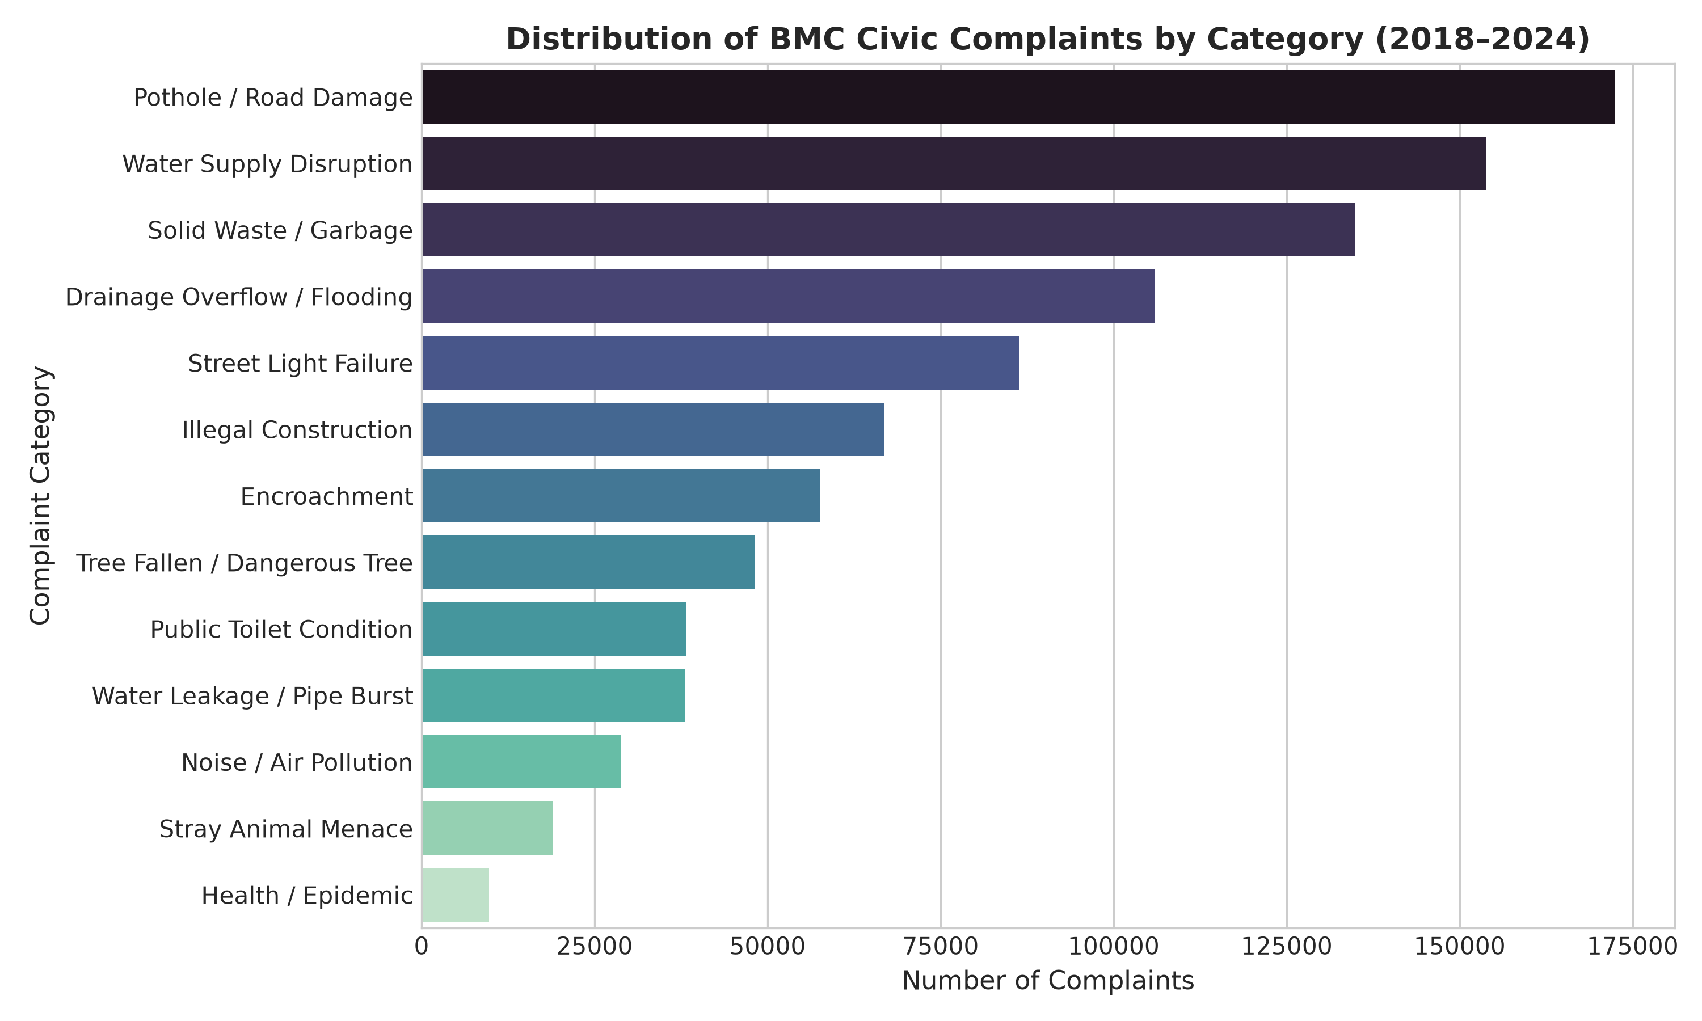
Dataset: Complaint Categories
Pothole / Road Damage is the largest complaint category.
Notes:
Use the original repository graph to describe the distribution. Do not infer precise counts from unlabelled bars or causal effects from the time series.
Source: outputs/figures/complaint_category_distribution.png; notebook EDA
Repository: https://github.com/Omkar-D-Londhe/BMC-Civic-Complaint-DWDM

Slide 12
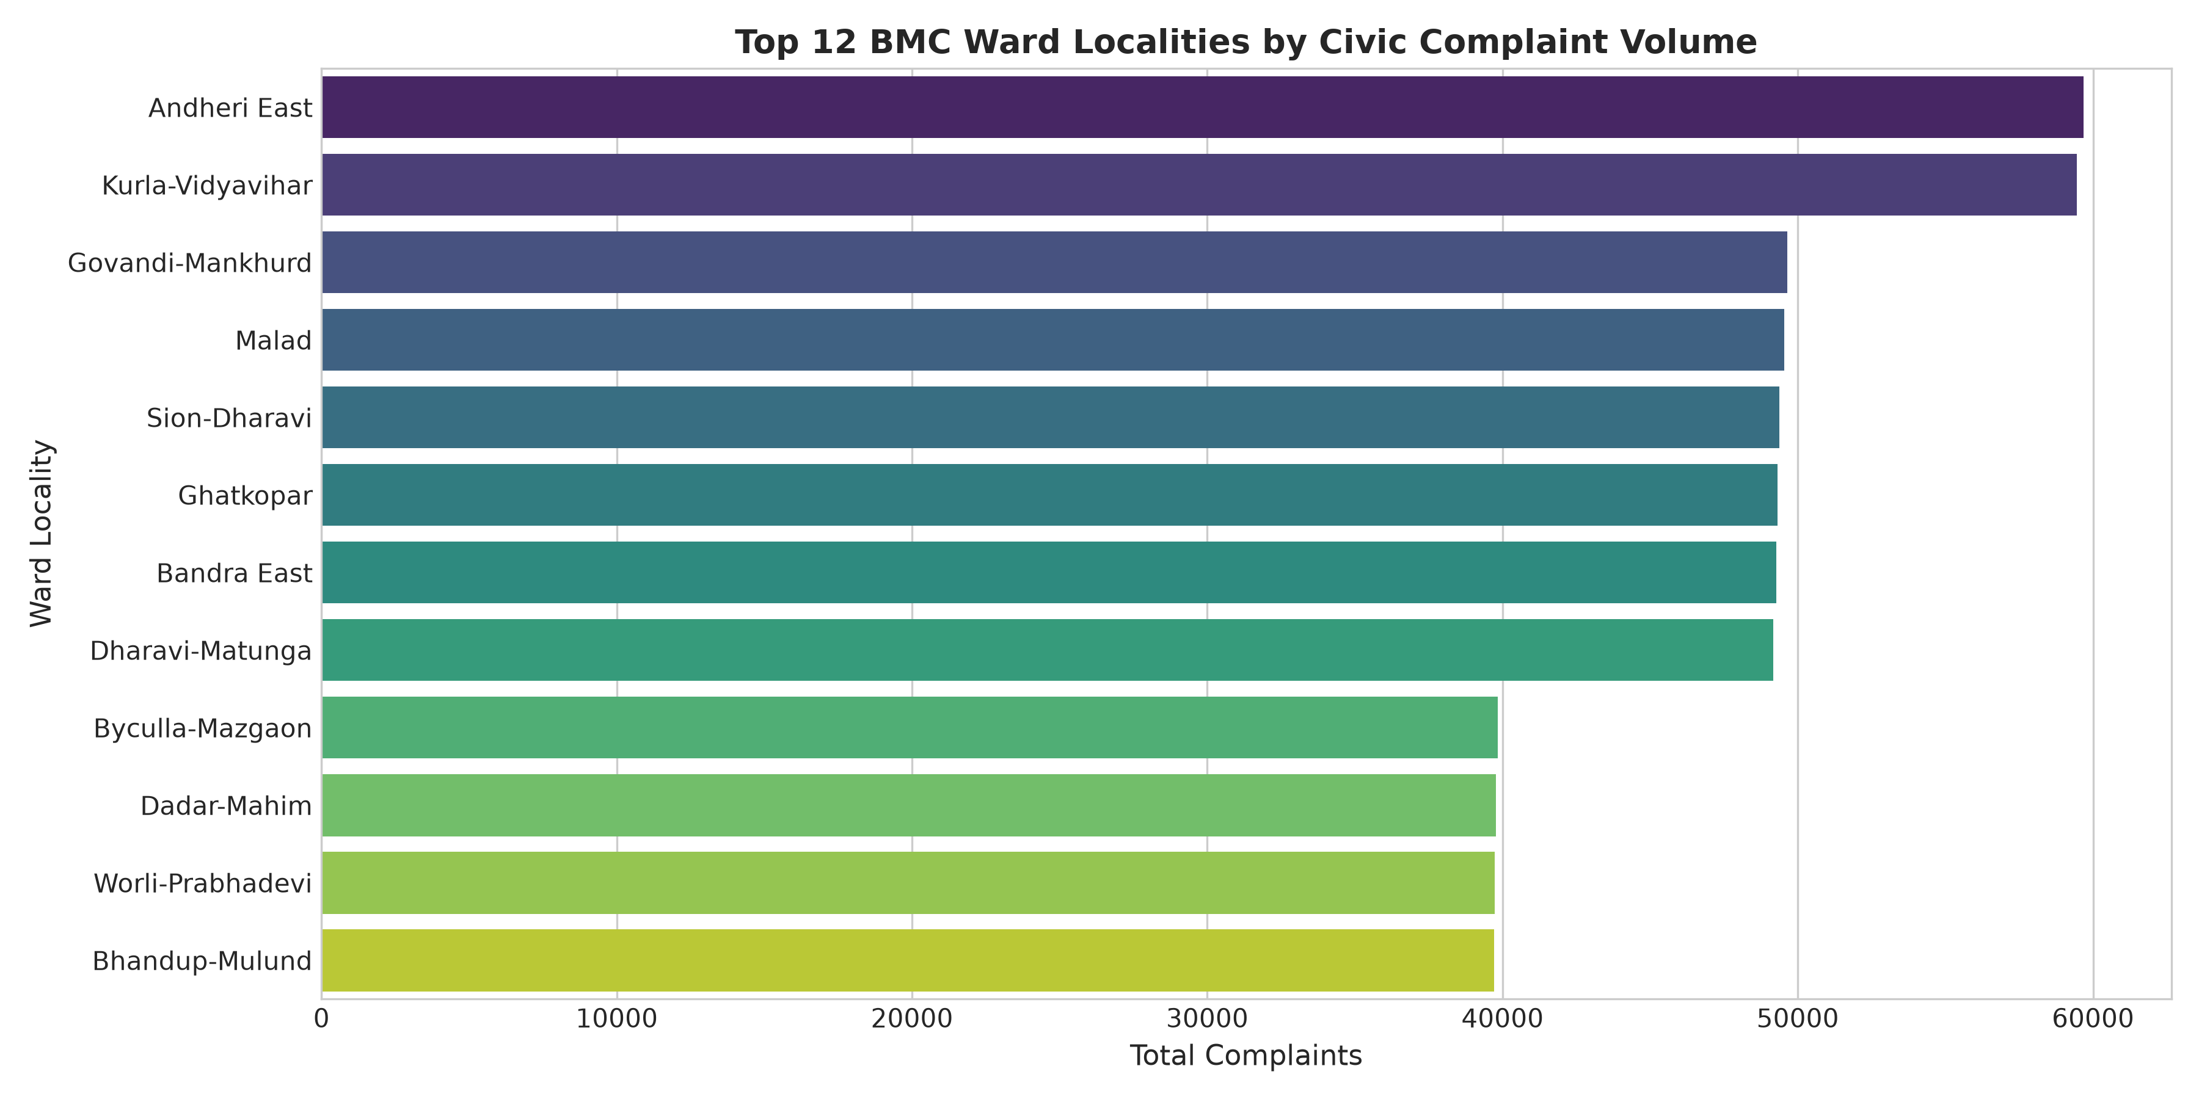
Dataset: Ward Hotspots
Andheri East and Kurla-Vidyavihar lead complaint volume.
Notes:
Use the original repository graph to describe the distribution. Do not infer precise counts from unlabelled bars or causal effects from the time series.
Source: outputs/figures/complaint_distribution_by_location.png; notebook EDA
Repository: https://github.com/Omkar-D-Londhe/BMC-Civic-Complaint-DWDM

Slide 13
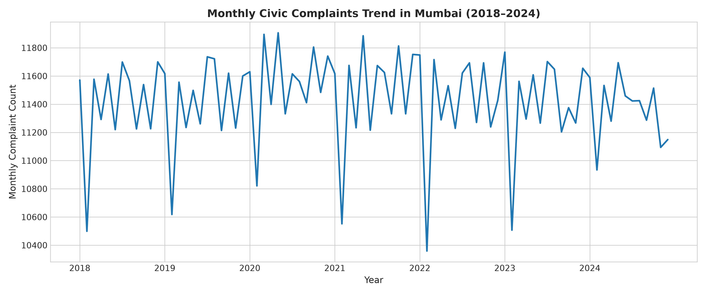
Dataset: Monthly Complaint Trend
The chart shows monthly complaint counts from 2018 to 2024.
Notes:
Use the original repository graph to describe the distribution. Do not infer precise counts from unlabelled bars or causal effects from the time series.
Source: outputs/figures/complaints_over_time.png; notebook EDA
Repository: https://github.com/Omkar-D-Londhe/BMC-Civic-Complaint-DWDM

Slide 14
Warehouse Design & ETL Results
Grain: one row per unique complaint_id | Load dimensions before fact_complaint so the foreign keys resolve
1 EXTRACT
Read bmc_train.csv (960,000 × 35) with pandas. Keep bmc_test.csv separate because citizen_satisfied is withheld.
2 PROFILE & CLEAN
Check schema and data types, parse complaint_date, standardize string, date and measure formats, drop duplicate complaint_id values.
3 TRANSFORM
Add calendar fields (day, month, month_name, quarter, year, day_of_week) and the monsoon flag (June–September). Set complaint_count = 1.
4 BUILD DIMENSIONS
Create unique time, location, category and status records, with integer surrogate keys and lookup maps.
5 LOAD FACTS
Map the four FKs on each complaint row and keep the measures and binary flags. Load dimensions first, then fact_complaint.
Warehouse table | Loaded rows
fact_complaint | 960,000
dim_time | 2,556
dim_location | 24
dim_category | 13
dim_status | 100
Notebook validation | Result
Orphan records across 4 FKs | 0
Missing source values | 0
Duplicate complaint IDs | 0
Notes:
These counts and checks are recorded in the executed notebook. They confirm warehouse loading and joins. No live ETL was rerun for this presentation. Time follows day, month, quarter, year. Location follows area, ward, zone. Category links to department.
Source: notebook cells 8–10 and profiling; README.md; sql/03_validation.sql
Repository: https://github.com/Omkar-D-Londhe/BMC-Civic-Complaint-DWDM

Slide 15
Code: Python ETL & Loaded Results
df_raw = pd.read_csv(raw_train_path)
df_cleaned = df_raw.copy()
df_cleaned = (df_cleaned
.drop_duplicates(subset=["complaint_id"])
.reset_index(drop=True))
dim_time["time_key"] = dim_time.index + 1
fact_complaint["time_key"] = (
df_cleaned["full_date"].map(time_lookup))
dim_time.to_sql("dim_time", engine,
if_exists="append", index=False,
chunksize=1000, method="multi")
fact_complaint.to_sql("fact_complaint", engine,
if_exists="append", index=False,
chunksize=20000, method="multi")
Loaded warehouse join: sample rows
Key | Date | Ward | Days | Cost INR
1 | 2024-09-20 | A | 37 | 1,500
2 | 2024-01-02 | P/N | 12 | 38,600
3 | 2022-04-12 | B | 6 | 13,000
4 | 2024-02-28 | M/E | 1 | 2,400
960,000 fact records
0 orphan foreign keys
Dimensions load before facts.
Excerpts cover extraction, key mapping and loading. Intermediate steps are left out.
Notes:
The code snippets are excerpts from the executed notebook, with line wrapping and redundant context trimmed. time_lookup, dimensions, fact DataFrame and engine are defined in omitted cells. The table contains the first four rows of the recorded warehouse join, not invented samples.
Source: notebooks/Week1_BMC_Complaint_Analysis.ipynb, ETL and warehouse validation outputs
Repository: https://github.com/Omkar-D-Londhe/BMC-Civic-Complaint-DWDM

Slide 16
OLAP Operations: Roll-up & Drill-down
Roll-up: ward to zone
Drill-down: year to month
SELECT l.zone,
COUNT(f.complaint_key) AS total_complaints
FROM fact_complaint f
JOIN dim_location l
ON f.location_key = l.location_key
GROUP BY l.zone
ORDER BY total_complaints DESC;
SELECT t.year, t.quarter, t.month,
SUM(f.complaint_count) AS total_complaints
FROM fact_complaint f
JOIN dim_time t ON f.time_key = t.time_key
WHERE t.year = 2024
GROUP BY t.year, t.quarter, t.month, t.month_name
ORDER BY t.quarter, t.month;
Zone | Complaints | Avg days
Western | 355,984 | 13.47
City | 346,769 | 13.8
Eastern | 257,247 | 14.01
2024 month | Complaints | Avg days
May | 11,694 | 12.23
June | 11,459 | 16.55
July | 11,423 | 16.68
September | 11,287 | 16.94
Western has the most complaints.
September’s average resolution time is 16.94 days.
Notes:
Roll-up aggregates wards into zones. Drill-down shows finer time detail within 2024. SQL excerpts trim selected measures; the result tables preserve columns from the full repository CSVs.
Source: sql/04_olap_queries.sql; outputs/tables/rollup_result.csv; outputs/tables/drilldown_result.csv
Repository: https://github.com/Omkar-D-Londhe/BMC-Civic-Complaint-DWDM

Slide 17
OLAP Operations: Slice & Dice
Slice: one category
Dice: category, zone and year
WHERE c.category_name =
'Pothole / Road Damage'
GROUP BY l.ward, l.ward_area, l.zone
ORDER BY pothole_complaints DESC;
WHERE c.category_name IN (
'Pothole / Road Damage',
'Water Supply Disruption',
'Drainage Overflow / Flooding')
AND l.zone IN ('Western', 'Eastern')
AND t.year = 2024
Filter and grouping excerpts from the full queries
Ward | Potholes | Avg days
K/E | 10,668 | 15.05
L | 10,596 | 18.17
H/E | 8,901 | 15.17
2024 zone / category | Count | Days
Eastern / Pothole | 6,450 | 15.64
Western / Pothole | 9,107 | 15.15
Eastern / Water supply | 5,903 | 9.33
Western / Water supply | 8,052 | 9.18
K/E leads pothole complaints.
Eastern potholes take 15.64 days to resolve.
Notes:
Slice fixes exactly one category. Dice restricts three dimensions. The table shows selected category results from the complete dice output, which also includes drainage. Code shows the actual filter clauses, not standalone executable queries.
Source: sql/04_olap_queries.sql; outputs/tables/slice_result.csv; outputs/tables/dice_result.csv
Repository: https://github.com/Omkar-D-Londhe/BMC-Civic-Complaint-DWDM

Slide 18
OLAP Operations: Pivot
Ward rows with complaint categories as columns
Result table (selected rows / columns)
SELECT l.ward, l.ward_area,
SUM(CASE WHEN c.category_name =
'Pothole / Road Damage'
THEN f.complaint_count ELSE 0 END)
AS pothole_roads,
SUM(CASE WHEN c.category_name =
'Water Supply Disruption'
THEN f.complaint_count ELSE 0 END)
AS water_supply,
SUM(f.complaint_count)
AS total_ward_complaints
FROM fact_complaint f
JOIN dim_location l
ON f.location_key = l.location_key
JOIN dim_category c
ON f.category_key = c.category_key
GROUP BY l.ward, l.ward_area
ORDER BY total_ward_complaints DESC;
Ward | Potholes | Water | Total
K/E | 10,668 | 9,540 | 59,673
L | 10,596 | 9,620 | 59,459
M/E | 8,894 | 7,998 | 49,648
P/N | 8,875 | 7,940 | 49,548
K/E has the most complaints overall: 59,673.
Notes:
Explain Ward rows with complaint categories as columns. K/E has the highest total ward complaints: 59,673. SQL retains the repository operation; selected output rows and columns are shown. Pivot displays two category columns in the query excerpt and additional water values from the full CSV. Numeric formatting adds separators without rounding.
Source: sql/04_olap_queries.sql; outputs/tables/pivot_result.csv
Repository: https://github.com/Omkar-D-Londhe/BMC-Civic-Complaint-DWDM

